Slide 1

Java SequenceInputStream class
The Java SequenceInputStream combines two or more other InputStream's into one. First the SequenceInputStream will read all bytes from the first InputStream, then all bytes from the second InputStream. That is the reason it is called a SequenceInputStream, since the InputStream instances are read in sequence.
Java SequenceInputStream class is used to read data from multiple streams. It reads data of streams one by one.
The SequenceInputStream class allows you to concatenate multiple InputStream’s.
InputStream[i.e.FileInputStream]
myfile1.txt
SequenceInputStream
Read
InputStream[i.e.FileInputStream]
Java Application
myfile2.txt
Read
InputStream[i.e.FileInputStream]
myfile3.txt
Read

Slide 2
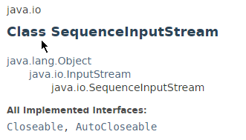
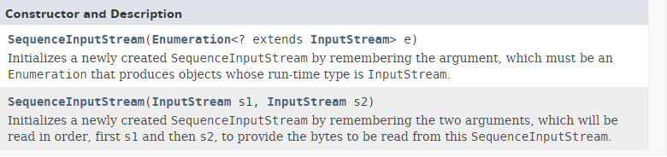
Java SequenceInputStream class

Slide 3
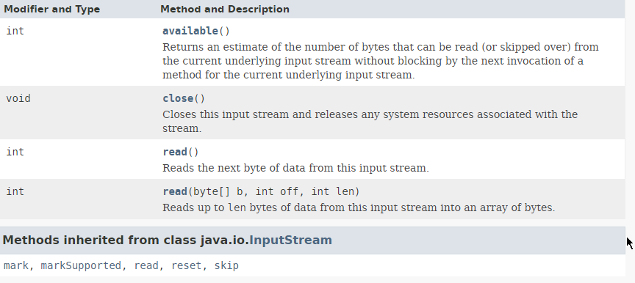
Java SequenceInputStream class

Slide 4
Java SequenceInputStream class
https://docs.oracle.com/javase/8/docs/api/index.html?java/io/SequenceInputStream.html

Slide 5
Java SequenceInputStream class

